Slide 1
LOAN MANAGEMENT SYSTEM
My SQL Project presentation
By Maheshwari Kannan

Slide 2
SQL
SQL (Structured Query Language) is a programming language designed for managing and manipulating data stored in relational database management systems (RDBMS).
Key Features:
1. Querying data: Selecting, filtering, and sorting data.
2. Data manipulation: Inserting, updating, and deleting data.
3. Data definition: Creating, modifying, and dropping database structures (tables, indexes, views).
4. Data control: Managing user access, permissions, and transactions.

Slide 3
SQL Components:
1. Commands (verbs): SELECT, INSERT, UPDATE, DELETE, CREATE, DROP.
2. Clauses: WHERE, FROM, GROUP BY, HAVING, ORDER BY.
3. Functions: SUM, COUNT, AVG, MAX, MIN.
4. Operators: =, <, >, LIKE, IN.
Basic SQL Queries:
1. SELECT * FROM table_name;
2. SELECT column1, column2 FROM table_name;
3. INSERT INTO table_name (column1, column2) VALUES ('value1', 'value2');
4. UPDATE table_name SET column1 = 'new_value' WHERE condition;
5. DELETE FROM table_name WHERE condition; Operators: =, <, >, LIKE, IN.

Slide 4
Commands used in SQL
Create : Creates a new table in the database.
Select : Retrieves data from a database.
Insert Into : Adds new records into a table.
Update : Modifies existing records in a table.
Alter : Modifies an existing table structure.
Drop : Deletes a table from the database.
Joins : Combines two or more tables.

Slide 5
Data Set user for this Project
1. customer income status
2. loan status
3. customer info
4. country state
5. region info

Slide 6
Import table from sheet 1- Customer income status set customer criteria based on applicant income
Query:
select * from customer_income;
select *,
Case
when (applicantincome >=15000) then "Grade A“
when (applicantincome >=9000) then "Grade B“
when (applicantincome >=5000) then "Grade C“
else"Low_class"end as "Grades“
from customer_income;

Slide 7
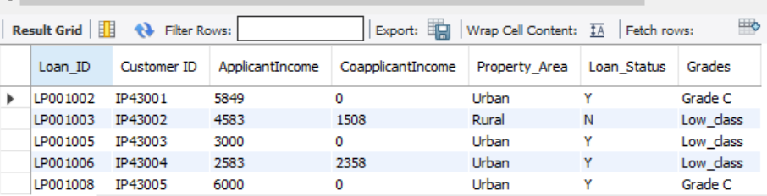
Output:

Slide 8
Monthly and Yearly Interest Percentage Calculation
Query:
create table loan_det1 select loan_amounts.loan_id,loan_amounts.customer_id,loan_amounts.loan_amount, loan_det.customer_interest_percentage from loan_amounts inner join loan_det on loan_amounts.loan_id= loan_det.Loan_id; SELECT loan_amount AS Principal, customer_interest_percentage / 100 AS Rate, ROUND((loan_amount * (customer_interest_percentage / 100)) / 12, 2) AS Monthly_interest, ROUND(loan_amount * (customer_interest_percentage / 100), 2) AS Yearly_interest FROM loan_det1;
select * from loan_det1;

Slide 9
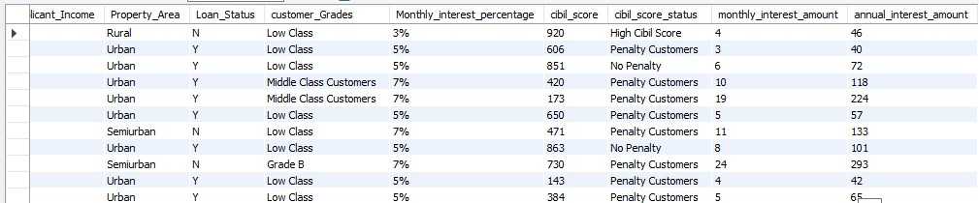
Output:

Slide 10
Sheet 2 - loan status
Create row level trigger for loan amt
Query:
delimiter %%
create trigger Loan_amount_null before insert on loan_amounts for each row
Begin
if new.loan_amount is null then setnew.loan_amount = "loan still processing";
end if;
end %%
delimiter ;

Slide 11
Create a Loan_amount and Remarks_update table.
Query:
create table loan_amounts(loan_id varchar(50), customer_id varchar(55), loan_amount varchar(100), loan_amount_term int, cibil_score int);
create table remarks_update(loan_id int, loan_amount varchar(100), cibil_score int, cibil_score_status varchar(100));

Slide 12
Create statement level trigger for cibil score
Query:
delimiter $$
create trigger remarks_update after insert on loan_amounts for each row
Begin
if new.cibil_score>900 then
insert intoremarks_update(loan_id,loan_amount,cibil_score,cibil_score_status)
values(new.loan_id,new. loan_amount,new.cibil_score,"High cibil score");
elseif new.cibil_score>750 then
insert into remarks_update(loan_id, loan_amount, cibil_score, cibil_score_status)
values(new.loan_id,new.loan_amount, new.cibil_score,"No Penalty");
elseif new.cibil_score > 100 then
Insert into remarks_update(loan_id,loan_amount,cibil_score,cibil_score_status)
values(new.loan_id,new. loan_amount,new.cibil_score, "penalty customers");
elseif new.cibil_score <=0 then
insert into remarks_update(loan_id,loan_amount,cibil_score,cibil_score_status)
values(new.loan_id,new. loan_amount,new.cibil_score, "Reject customers");
end if;
end $$
delimiter ;

Slide 13
After creating Triggers, we have to insert the values into the Tables.
Query:
insert into loan_amount values
('LP001002', 'IP43001', Null, 360,303),
('LP001003', 'IP43002', 128, 360, 920),
('LP001005', 'IP43003', 66, 360, 606),
('LP001006', 'IP43004', 120, 360, 851),
('LP001008', 'IP43005', 141, 360, 420),
('LP001011', 'IP43006', 267, 360, 173),
('LP001013', 'IP43007', 95, 360, 650),
('LP001014', 'IP43008', 158, 360, 471),
('LP001018', 'IP43009', 168, 360, 863),
('LP001020', 'IP43010', 349, 360, 730),
and continues….

Slide 14
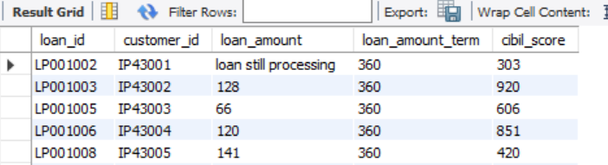
Output for the Row Level trigger:

Slide 15
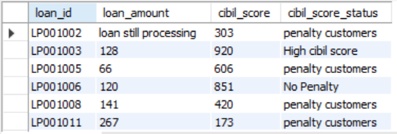
Output for statement level trigger

Slide 16
SHEET 3 Import the customer_info table and update the age and gender column for the particular customers .
Query:
update customer_info set gender = 'female'where customer_id ="IP43006";
update customer_info set gender = 'female'where customer_id ="IP43016";
update customer_info set gender = 'female'where customer_id ="IP43508" or customer_id ="IP43577" or customer_id ="IP43589" or customer_id ="IP43593";
update customer_info set gender = 'Male'where customer_id ="IP43018" or customer_id ="IP43038";
update customer_info set age = 45 where customer_id= "IP43007";
update customer_info set age = 32 where customer_id= "IP43009";
select * from customer_info;

Slide 17
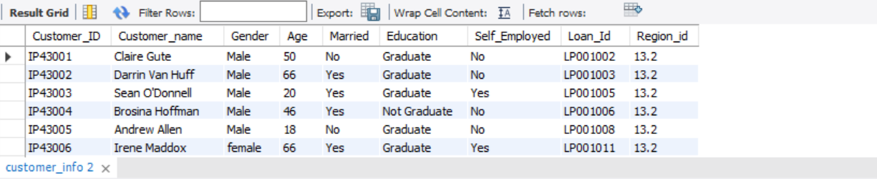
Output for update Gender and Age:

Slide 18
Import the country_state and region_info tables. 1. We have to join the five tables without repeating columns.
Query:
select loan_cibil_score_status_det.loan_id, loan_cibil_score_status_det.customer_id, customer_info.customer_name, customer_info.gender, customer_info.age, customer_info.married, customer_info.education, customer_info.self_employed, loan_cibil_score_status_det.loan_amount, loan_cibil_score_status_det.loan_amount_term,loan_cibil_score_status_det.cibil_score, loan_cibil_score_status_det.cibil_score_status, customer_income.applicantincome, customer_income.coapplicantincome, customer_income.property_area,customer_income.loan_status,country_state2.postal_code,country_state2.segment,country_state2.statefrom loan_cibil_score_status_detinner join customer_income on loan_cibil_score_status_det.loan_id= customer_income.loan_idinner join customer_info on loan_cibil_score_status_det.loan_id= customer_info.loan_idinner join country_state2 on loan_cibil_score_status_det.loan_id= country_state2.loan_idinner join loan_det1 on loan_cibil_score_status_det.loan_id= loan_det1.loan_idinner join loan_det on loan_cibil_score_status_det.loan_id= loan_det.loan_id;

Slide 19
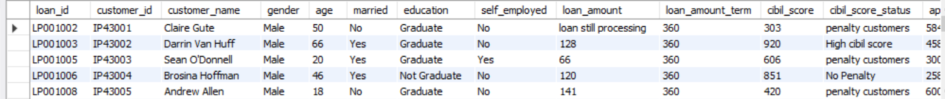
Output for joining all the 5 Tables

Slide 20
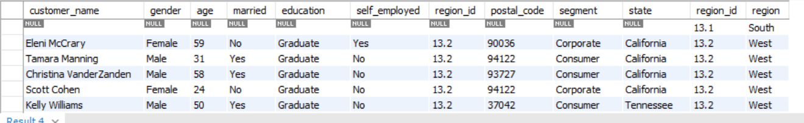
Output: the mismatching value is region_id=13.1.

Slide 21
Filtering high_cibil_score_status customers.
Query:
select loan_cibil_score_status_det.loan_id, loan_cibil_score_status_det.customer_id, customer_info.customer_name, customer_info.gender, customer_info.age, customer_info.married, customer_info.education, customer_info.self_employed, loan_cibil_score_status_det.loan_amount, loan_cibil_score_status_det.loan_amount_term,loan_cibil_score_status_det.cibil_score, loan_cibil_score_status_det.cibil_score_status, customer_income.applicantincome, customer_income.coapplicantincome, customer_income.property_area,customer_income.loan_status,country_state2.postal_code,country_state2.segment,country_state2.state from loan_cibil_score_status_detinner join customer_income on loan_cibil_score_status_det.loan_id= customer_income.loan_idinner join customer_info on loan_cibil_score_status_det.loan_id= customer_info.loan_idinner join country_state2 on loan_cibil_score_status_det.loan_id= country_state2.loan_idinner join loan_det1 on loan_cibil_score_status_det.loan_id= loan_det1.loan_idinner join loan_det on loan_cibil_score_status_det.loan_id= loan_det.loan_idwhere cibil_score_status = "high cibil score";

Slide 22
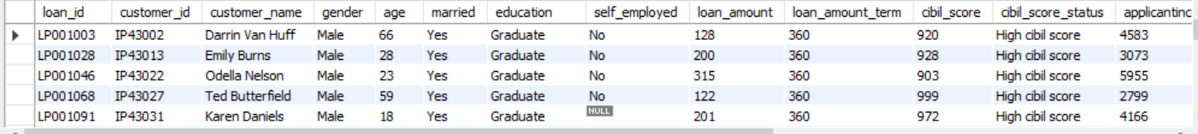
Output for filtering the “High_cibil_score_status”

Slide 23
Filtering the home office and corporate segments in country_state2 table.
Query:
select loan_cibil_score_status_det.loan_id, loan_cibil_score_status_det.customer_id, customer_info.customer_name, customer_info.gender, customer_info.age, customer_info.married, customer_info.education, customer_info.self_employed, loan_cibil_score_status_det.loan_amount, loan_cibil_score_status_det.loan_amount_term,loan_cibil_score_status_det.cibil_score, loan_cibil_score_status_det.cibil_score_status, customer_income.applicantincome, customer_income.coapplicantincome, customer_income.property_area,customer_income.loan_status,country_state2.postal_code,country_state2.segment,country_state2.state from loan_cibil_score_status_detinner join customer_income on loan_cibil_score_status_det.loan_id= customer_income.loan_idinner join customer_info on loan_cibil_score_status_det.loan_id= customer_info.loan_idinner join country_state2 on loan_cibil_score_status_det.loan_id= country_state2.loan_idinner join loan_det1 on loan_cibil_score_status_det.loan_id= loan_det1.loan_idinner join loan_det on loan_cibil_score_status_det.loan_id= loan_det.loan_id where segment = "home office" or segment= "corporate";

Slide 24
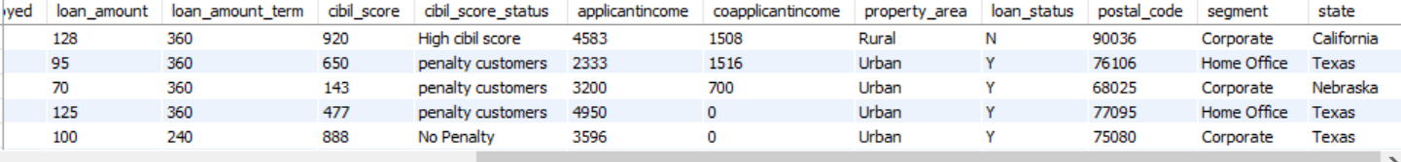
Output for filtering the home office and corporate in country_state2 table

Slide 25
Procedure:
A stored procedure is a reusable SQL code block that performs a specific task, that you can save.
So the code can be reused over and over again. So if you have an SQL query that you write over and over again, save it as a stored procedure, and then just call it to execute it.

Slide 26
Procedure for all the five outputs
Query:
delimiter //
create procedure LMSoutput()
Begin
customer_info.customer_name,customer_info.gender,customer_info.age, customer_info.married,customer_info.education,customer_info.self_employed,customer_info.region_id,country_state2.postal_code,country_state2.segment,country_state2.state,region_info.region_id,region_info.regionfrom customer_infoinner join country_state2 on customer_info.customer_id=country_state2.customer_idright join region_info on customer_info.region_id=region_info.region_id;
select loan_cibil_score_status_det.loan_id, loan_cibil_score_status_det.customer_id, customer_info.customer_name, customer_info.gender, customer_info.age, customer_info.married, customer_info.education, customer_info.self_employed, loan_cibil_score_status_det.loan_amount, loan_cibil_score_status_det.loan_amount_term,loan_cibil_score_status_det.cibil_score, loan_cibil_score_status_det.cibil_score_status, customer_income.applicantincome, customer_income.coapplicantincome,

Slide 27
customer_income.property_area,customer_income.loan_status,country_state2.postal_code,country_state2.segment,country_state2.statefrom loan_cibil_score_status_detinner join customer_income on loan_cibil_score_status_det.loan_id= customer_income.loan_idinner join customer_info on loan_cibil_score_status_det.loan_id= customer_info.loan_idinner join country_state2 on loan_cibil_score_status_det.loan_id= country_state2.loan_idinner join loan_det1 on loan_cibil_score_status_det.loan_id= loan_det1.loan_idinner join loan_det on loan_cibil_score_status_det.loan_id= loan_det.loan_id;
select loan_cibil_score_status_det.loan_id, loan_cibil_score_status_det.customer_id, customer_info.customer_name, customer_info.gender, customer_info.age, customer_info.married, customer_info.education, customer_info.self_employed, loan_cibil_score_status_det.loan_amount, loan_cibil_score_status_det.loan_amount_term,loan_cibil_score_status_det.cibil_score, loan_cibil_score_status_det.cibil_score_status, customer_income.applicantincome, customer_income.coapplicantincome,

Slide 28
customer_income.property_area,customer_income.loan_status,country_state2.postal_code,country_state2.segment,country_state2.state from loan_cibil_score_status_detinner join customer_income on loan_cibil_score_status_det.loan_id= customer_income.loan_idinner join customer_info on loan_cibil_score_status_det.loan_id= customer_info.loan_idinner join country_state2 on loan_cibil_score_status_det.loan_id= country_state2.loan_idinner join loan_det1 on loan_cibil_score_status_det.loan_id= loan_det1.loan_idinner join loan_det on loan_cibil_score_status_det.loan_id= loan_det.loan_idwhere cibil_score_status = "high cibil score";
select loan_cibil_score_status_det.loan_id, loan_cibil_score_status_det.customer_id, customer_info.customer_name, customer_info.gender, customer_info.age, customer_info.married, customer_info.education, customer_info.self_employed, loan_cibil_score_status_det.loan_amount, loan_cibil_score_status_det.loan_amount_term,loan_cibil_score_status_det.cibil_score, loan_cibil_score_status_det.cibil_score_status, customer_income.applicantincome, customer_income.coapplicantincome, customer_income.property_area,customer_income.loan_status,country_state2.postal_code,country_state2.segment,country_state2.state from loan_cibil_score_status_detinner join customer_income on loan_cibil_score_status_det.loan_id= customer_income.loan_idinner join customer_info on loan_cibil_score_status_det.loan_id= customer_info.loan_idinner join country_state2 on loan_cibil_score_status_det.loan_id= country_state2.loan_idinner join loan_det1 on loan_cibil_score_status_det.loan_id= loan_det1.loan_idinner join loan_det on loan_cibil_score_status_det.loan_id= loan_det.loan_idwhere segment = "home office" or segment= "corporate";
end //
delimiter ;
call LMSoutput;

Slide 29
Thank You!

